Slide 1
2024-25 Prior Learning Assessment (PLA) Report
Office of the Commissioner of Higher Education

Slide 2
MUS Accepted PLA Credits
Standardized Tests- AP, CLEP, DSST/DANTES, IB, Straighterline and UExcel
Challenge Exams- comprehensive exams of the course subject matter
Portfolio Assessments- students submit a portfolio showcasing their knowledge for faculty evaluation
American Council on Education (ACE) and National College Credit Recommendation Service (NCCRS)- proposes college credit equivalencies for learning outside of the college classroom
Military Credit- credits earned by branches of the US military
Experiential Learning- credits earned through work experience or learning outside of the college classroom

Slide 3
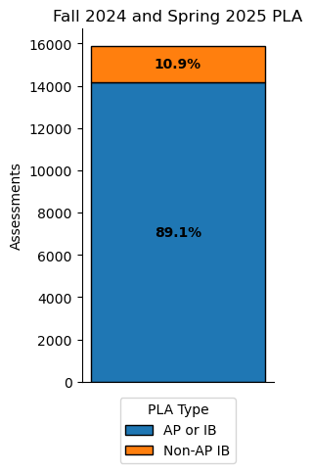
PLA by Semester
PLA Credits | Fall 2023 | Spring 2024 | Fall 2025 | Spring 2025
Advanced Placement (AP) | 6609 | 6224 | 6630 | 6237
Military | 267 | 261 | 269 | 259
Challenge | 92 | 90 | 77 | 62
College-Level Examination Program (CLEP) | 145 | 130 | 125 | 115
International Baccalaureate (IB) | 653 | 628 | 673 | 625
Other: Experiential Learning, ACE, Portfolio, Straighterline, Dantes, UExcel and Other | 509 | 498 | 426 | 396
Total | 8276 | 7832 | 8202 | 7694
7,968 students were awarded credit in 2024-25

Slide 4
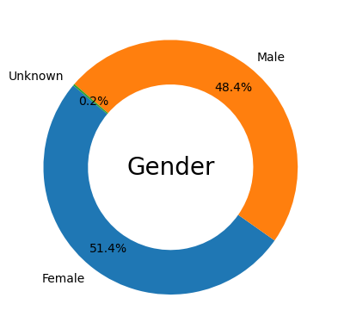
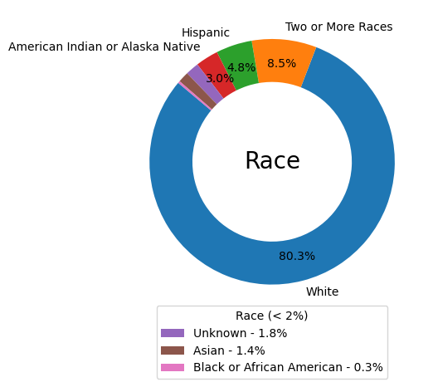
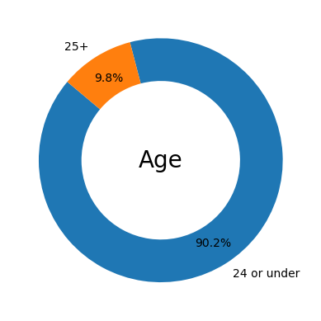
2024-25 PLA Student Demographics

Slide 5
2024-25 PLA Demographics Compared
Demographics | All PLA | AP & IB | Non-AP/IB
Female | 52% | 53% | 43%
Male | 48% | 47% | 57%
24 or under | 90% | 94% | 61%
25+ | 10% | 6% | 39%
White | 80% | 81% | 76%
Two or More Races | 9% | 9% | 7%
Hispanic | 5% | 4% | 7%
American Indian or Alaska Native | 3% | 3% | 4%
Unknown | 2% | 2% | 3%
Asian | 1% | 1% | 1%
Black or African American | 0% | 0% | 1%
Native Hawaiian or Other Pacific Islander | 0% | 0% | 0%
Non-Veteran | 94% | 97% | 69%
Veteran | 6% | 3% | 31%

Slide 6
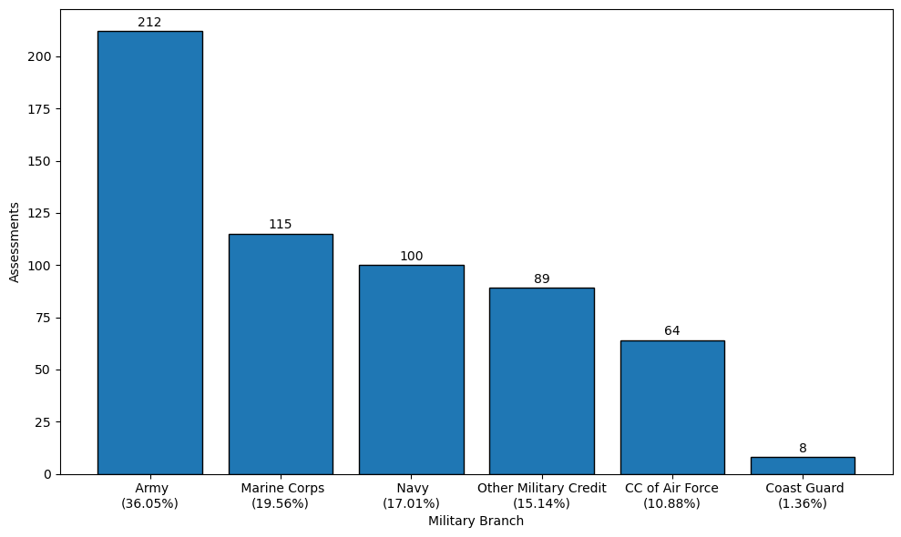
2024-25 Military Credits by Branch
339 out of 543 (62.4%) of veteran students that were awarded PLA credits used military transcripts in 2024-25

Slide 7
2024-25 PLA by Campus
PLA | City College | Dawson CC | Flathead Valley CC | Gallatin College | Great Falls College | Helena College | Highlands College | MSU- Northern | MSU-Billings | MSU-Bozeman | MT Tech | Miles CC | Missoula College | UM-Missoula | UM-Western | Total
Advanced Placement (AP) | 31 | 9 | 324 | 110 | 42 | 24 | 8 | 26 | 231 | 8389 | 531 | 0 | 79 | 2938 | 125 | 12867
Challenge | 10 | 0 | 5 | 5 | 16 | 4 | 2 | 0 | 51 | 22 | 19 | 0 | 2 | 3 | 0 | 139
College-Level Examination Program (CLEP) | 6 | 0 | 6 | 4 | 27 | 0 | 1 | 2 | 11 | 171 | 2 | 0 | 0 | 8 | 2 | 240
International Baccalaureate (IB) | 0 | 0 | 231 | 5 | 2 | 0 | 0 | 4 | 11 | 616 | 25 | 0 | 7 | 376 | 21 | 1298
Military | 16 | 0 | 37 | 2 | 8 | 23 | 4 | 0 | 60 | 257 | 9 | 4 | 5 | 96 | 7 | 528
Other: Experiential Learning, ACE, Portfolio, Straighterline, Dantes, UExcel and Other | 11 | 2 | 3 | 1 | 54 | 6 | 2 | 0 | 73 | 596 | 21 | 0 | 15 | 35 | 5 | 824
Total | 74 | 11 | 606 | 127 | 149 | 57 | 17 | 32 | 437 | 10051 | 607 | 4 | 108 | 3456 | 160 | 15896

Slide 8
2024-25 PLA Statistics
23.3% of undergraduate students in MUS have PLA credits
16.9% of undergraduate students in the MUS age 25+ have PLA credits
37.2% of undergraduate veteran students have PLA credits

Slide 9
PLA Information
Website:
https://www.mus.edu/pla/
Contact:
Jacque Treaster
jtreaster@montana.edu
(406) 449-9135

