Slide 1
MSU Billings Community Taskforce Recommendations
Presentation to the
Montana Board of Regents
March 8, 2018

Slide 2
Background
In the spring of 2017, Commissioner Clayton Christian created the MSU Billings (MSUB) Community Taskforce.
Deputy Commissioner of Higher Education John Cech facilitated the taskforce, which included Regent Martha Sheehy, MSUB Interim Chancellor Ron Larsen, broad representation from the community as well as faculty, staff, and administration from the university.

Slide 3
Community leaders from
Anner-Hughes Law Firm
Billings Chamber of Commerce
Billings Clinic
Billings Gazette
Billings Public Schools
Big Sky Economic Development
Chief Dull Knife College
City College
City of Billings, City Council
ExxonMobil
First Interstate Bank
McDonald Land Development
Montana House of Representatives
Montana State University
MSU Billings
Montana University System
Northern Hotel
NorthWestern Energy
Rimrock Foundation
Sanderson Stewart
Sibayne-Stillwater
St. John’s Lutheran Ministries
St. Vincent Healthcare
Underriner Motors

Slide 4
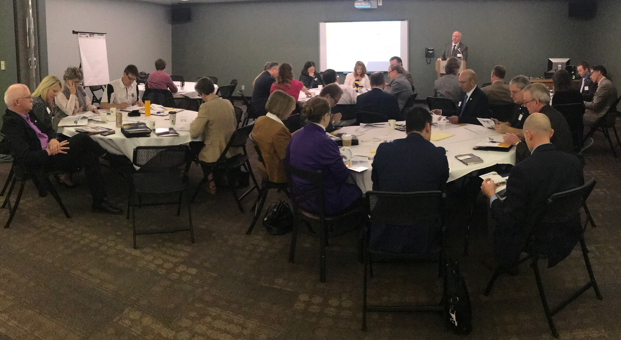

Slide 5
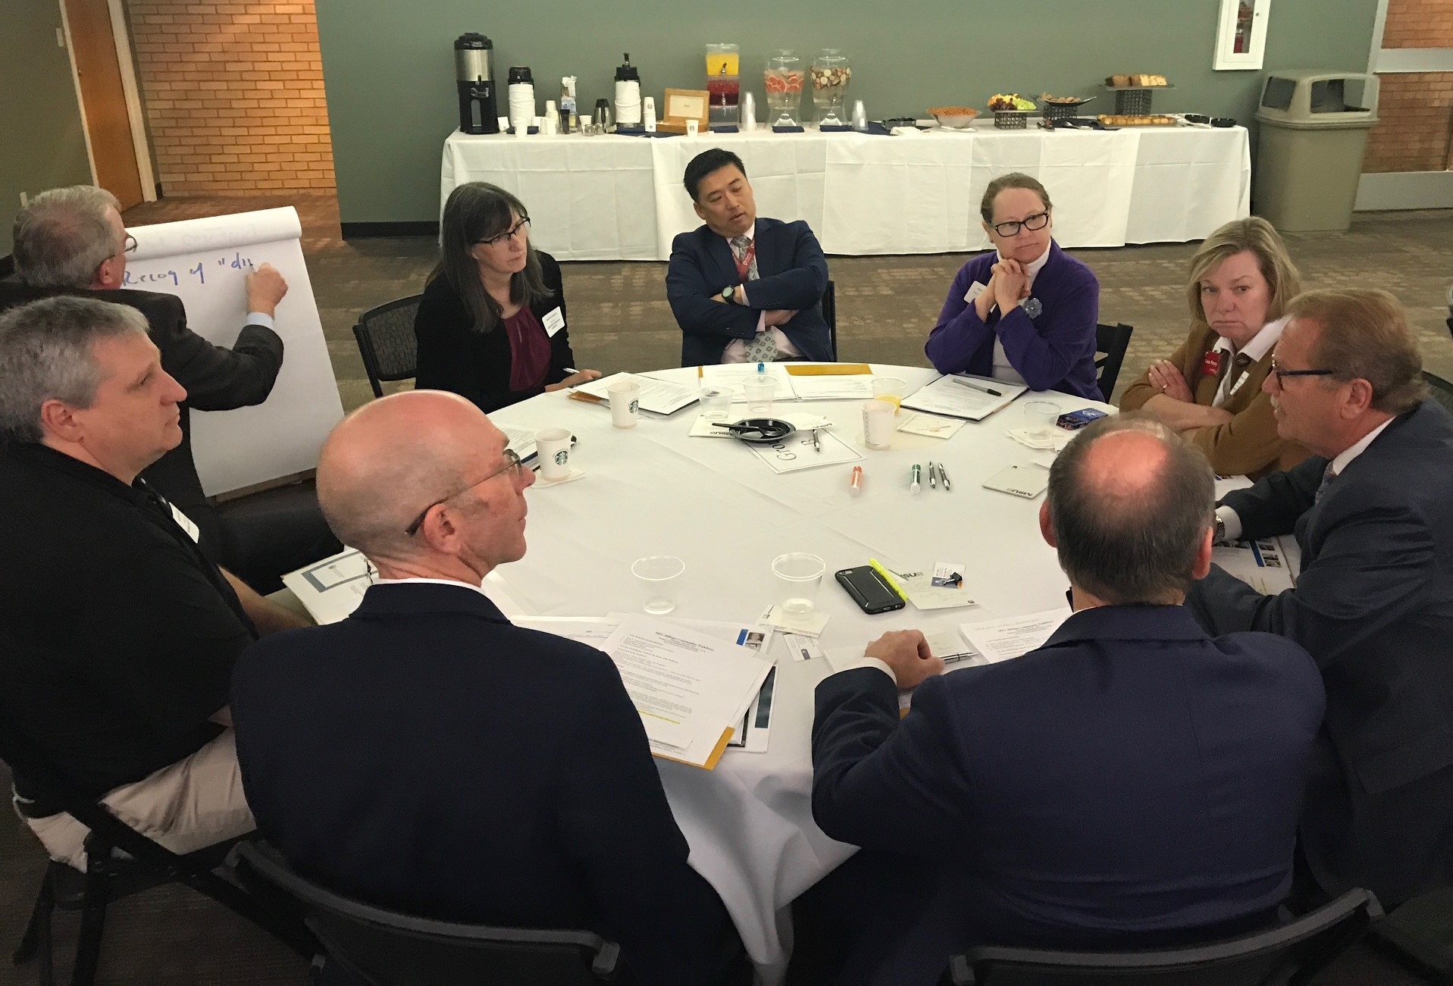
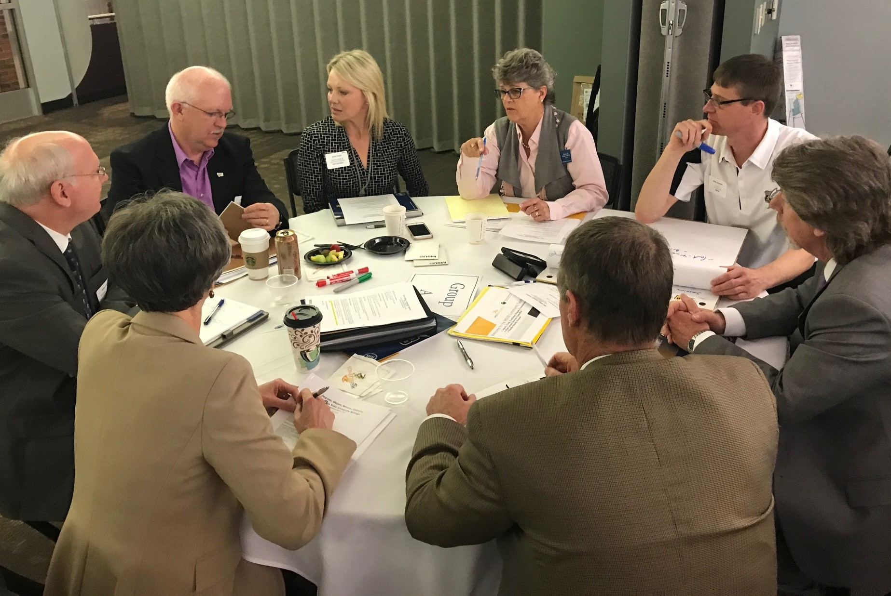

Slide 6
Goals
This taskforce sought to engage the broader community/region in MSUB’s visioning effort. Goals included:
Strengthening the university’s connection and responsiveness with the community/region.
Providing a community sounding board to the internal visioning efforts occurring on campus.
Developing strategies, partnership ideas, and suggesting strategies for growing enrollment.

Slide 7
Process
The taskforce met monthly from April 2017 through February 2018 to gather input from members on the university. The recommendations are grouped into five pillars:
Leadership
Student Success
Program Offerings
Marketing and Identity Branding
Facilities/Infrastructure

Slide 8
Pillar 1 - Leadership
Stable leadership at MSUB will engage community to strategically move the university forward. Recommendations include:
Recruit and retain stable leadership
Quickly fill interim positions
Nurture crucial community partnerships
Work alongside community to plan, conduct philanthropy, and advocate for the university

Slide 9
Pillar 2 – Student Success
MSUB will place the success of its diverse student population as its highest priority.
Develop best-practice pathways for students from admissions outreach to graduation.
Improve academic and advisory support for both traditional and non-traditional students.
Expand links to career and professional opportunities and employment.

Slide 10
Pillar 3 – Program Offerings
MSUB will differentiate itself by building professional pathways in healthcare, business, education and applied technologies.
Conduct an industry-led assessment to bridge industry needs and academic offerings.
Enhance professional pathways through applied and experiential learning and dual credit.
Regularly review programs to focus energy on in-demand areas.
Recognize the unique role of faculty in curriculum development.

Slide 11
Pillar 4 – Marketing & Identity Branding
MSUB will deploy focused marketing and communication that establishes a respected and unique identity, grows enrollment, and fosters community pride.
Implement a new, comprehensive marketing plan, informed via regular analysis.
Develop systematic and continuous communications with all campus constituencies, community, and media.

Slide 12
Pillar 5 – Facilities/Infrastructure
MSUB will develop its physical plan to provide attractive hubs for education, community, and business for the region.
Complete fundraising and break ground on the Yellowstone Science and Allied Health Building.
Effective communication about the university as an event venue.
Develop City College as a western “gateway” for career pathways and capitalize on Shiloh Corridor development momentum.
Take down the former Academic Support Center.
Begin long-term plans to renovate student residence facilities.

Slide 13
Words from the taskforce members
Starting-point
Impactful
Enlightening
Behemoth
Eye-opening
Refreshing
Challenging
Hopeful
Educational
Community
Energizing
Connections
Grounding
Jumping-off-point
Evolution
Fragile

Slide 14
What’s next?
Form a Chancellor’s Community Advisory Board with representation from key industries in our region
Develop an action plan from recommendations, identifying new items vs. initiatives already underway in the university
Incorporate the recommendations into our next strategic planning process
Communicate regularly to the community about progress
Seek additional funding for key recommendations

Slide 15
Thank you
Questions and comments are welcome!

